Slide 1
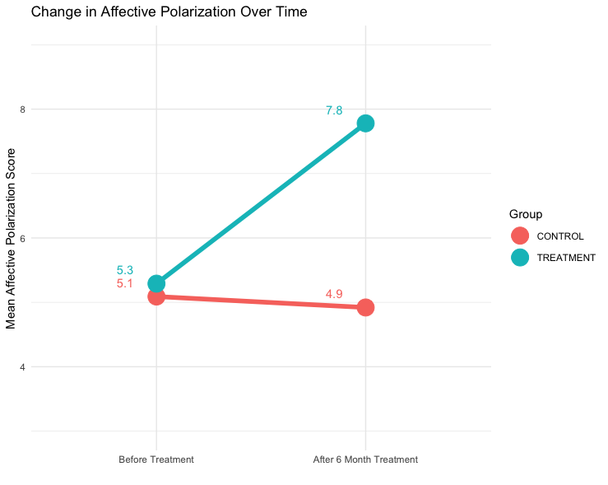
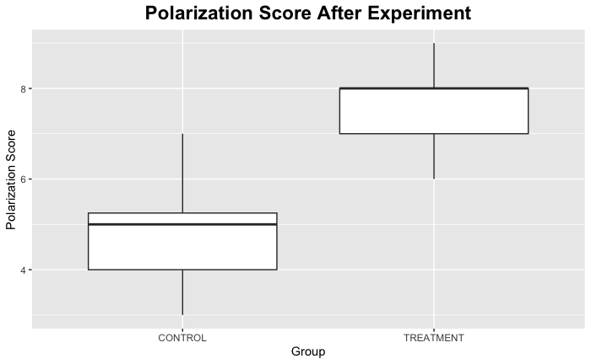
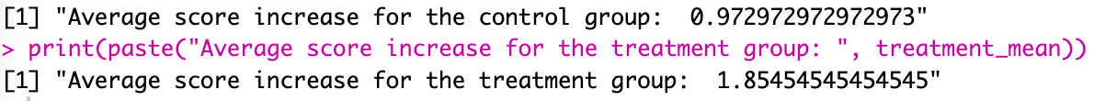
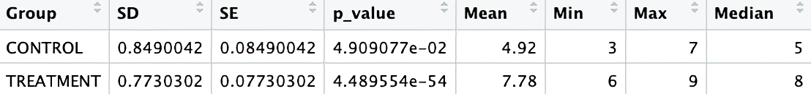
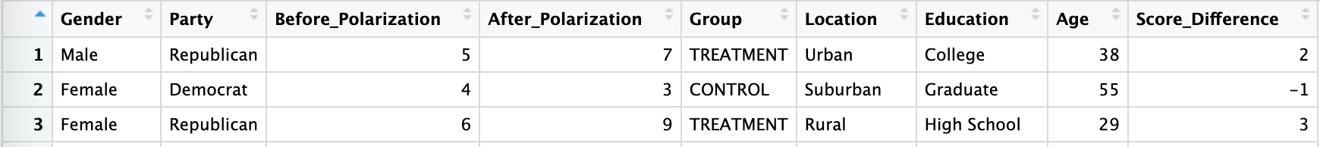
How does extensive usage of popular social media platforms (like Facebook, Twitter, Instagram, and TikTok) contribute to affective polarization in the United States? Are individuals who spend more time on social media more prone to develop intensely negative feelings towards opposing political groups?
t-value: 29

